Slide 1


Being Health
The Assessment of
Medical Image Quality
Department: Value Lab
Speaker: Martin Lin
Date: 2019/08/29
Notes:
自我介紹

Slide 2



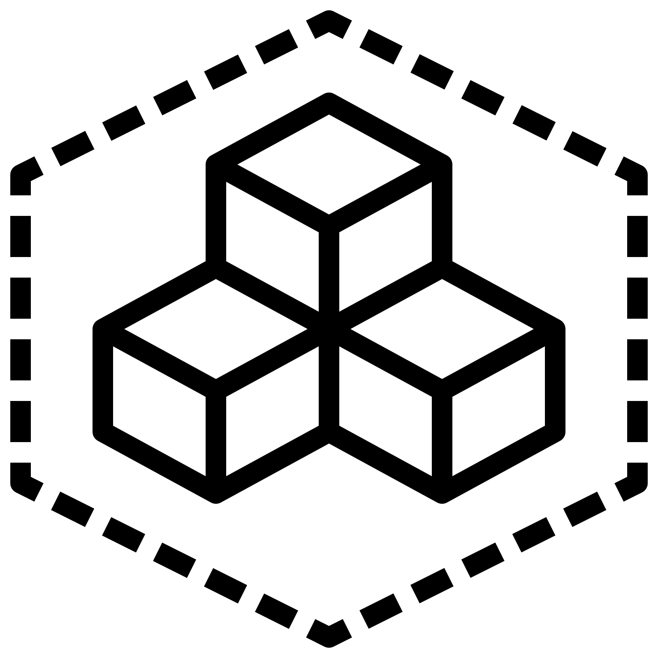

Outline
Introduction
Dataset
Image Preprocessing
Model Selection
Result

Slide 3
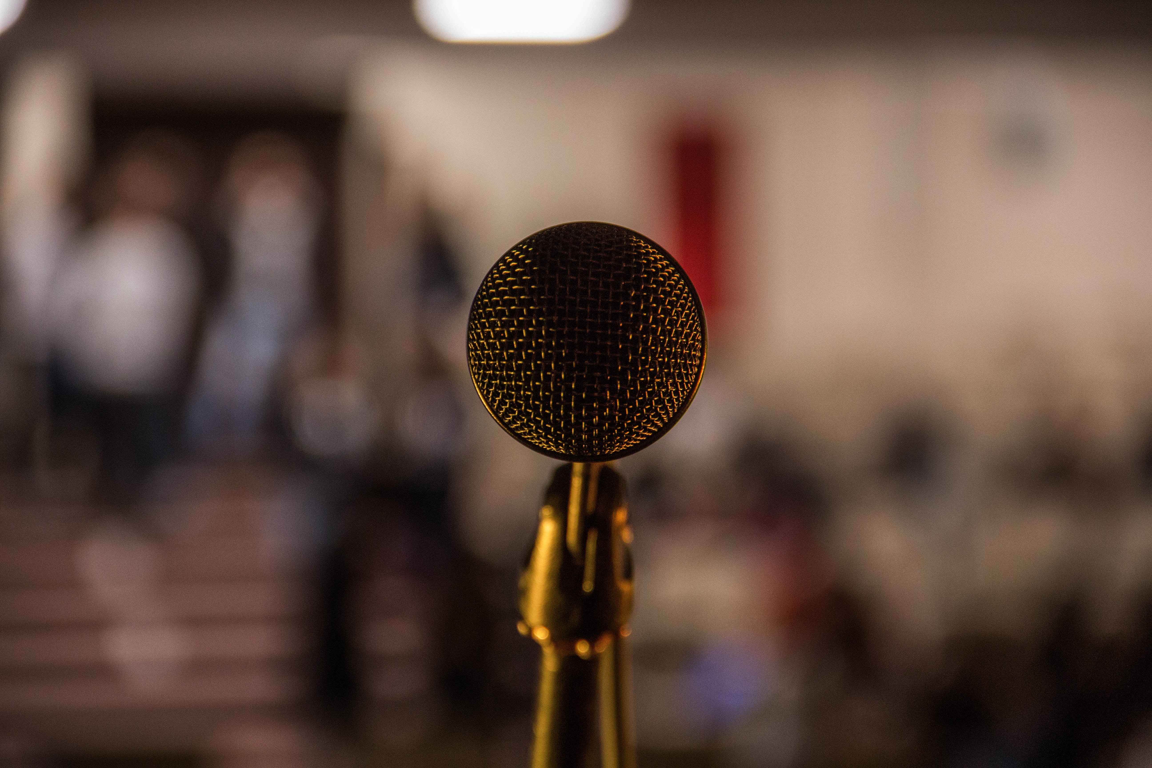
Introduction

Slide 4




Introduction
Diabetes
1 : 500
1,808
7% ( > 18 years old)
1,000,000
Introduction
Dataset
Image preprocessing
Model selection
Result
Notes:
篩檢

Slide 5
Introduction
Chronic Complications of diabetes
Diabetes
Diabetic retinopathy
Diabetic nephropathy
Diabetic neuropathy
Introduction
Dataset
Image preprocessing
Model selection
Result
Notes:
Why use Image Quality

Slide 6

Dataset

Slide 7
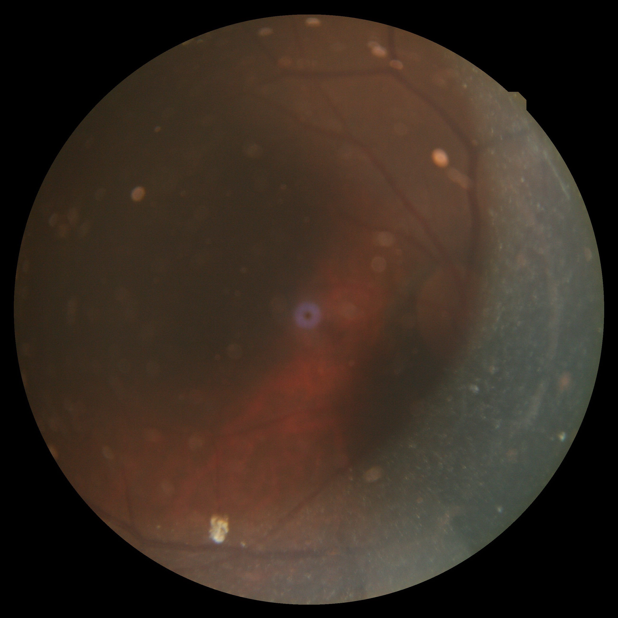
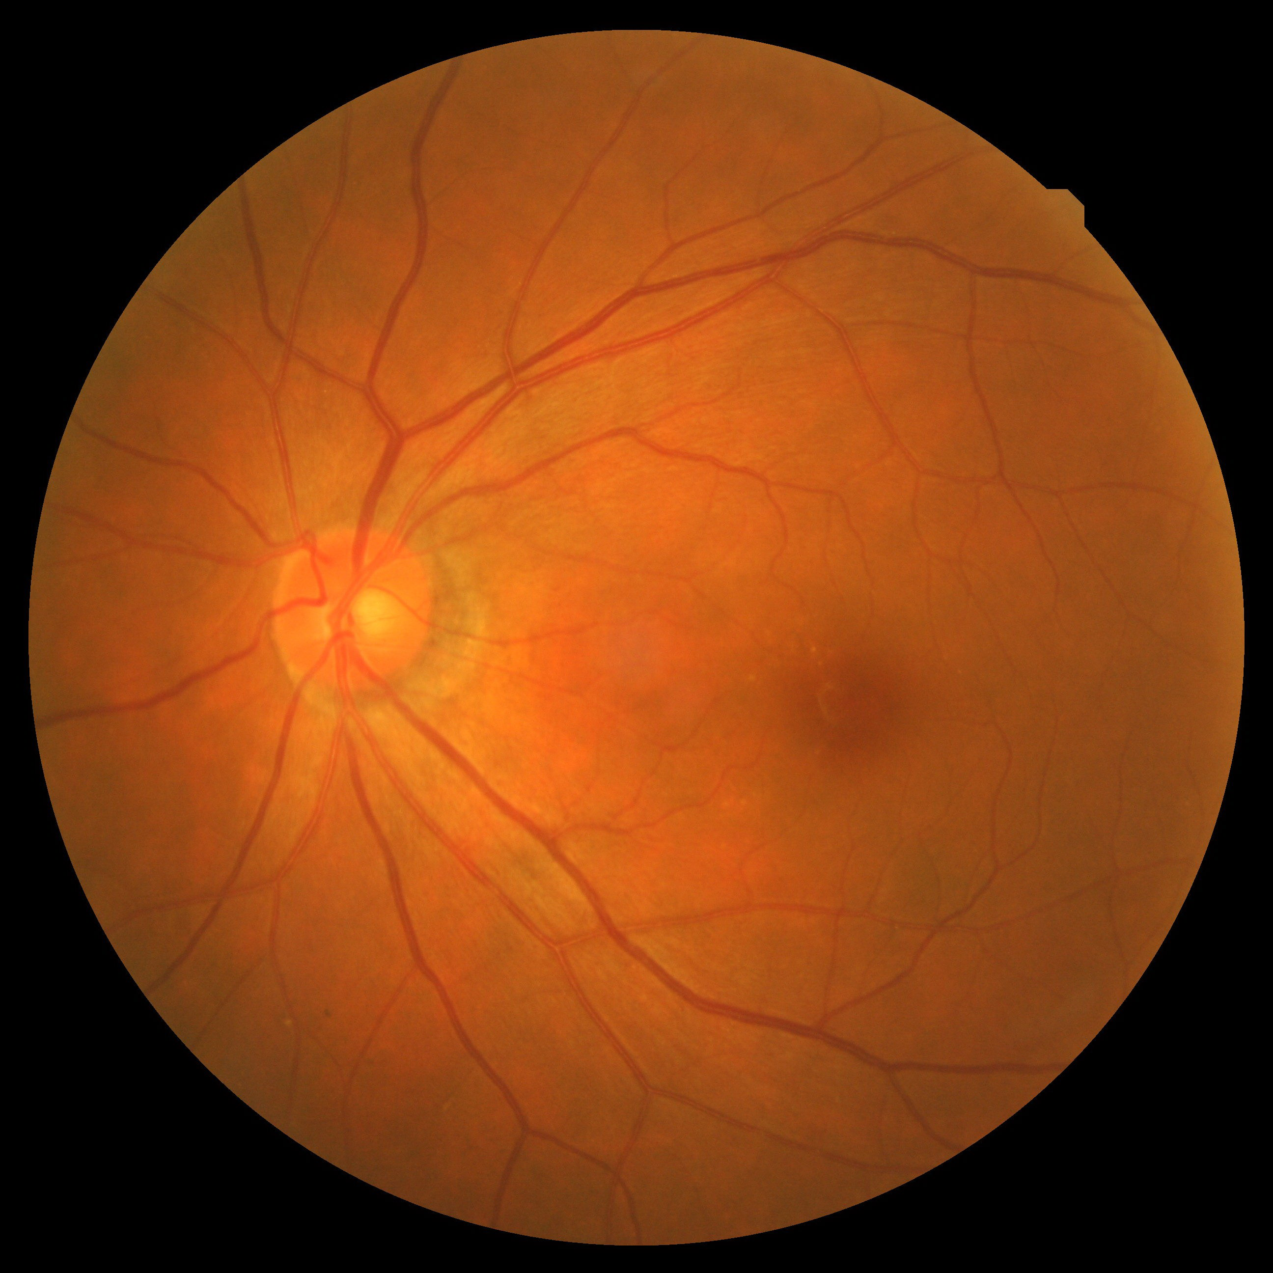
Dataset
Poor Quality Label: 0
High Quality
Label: 1
Dataset
Introduction
Dataset
Image processing
Image preprocessing
Model selection
Model selection
Result
Result

Slide 8


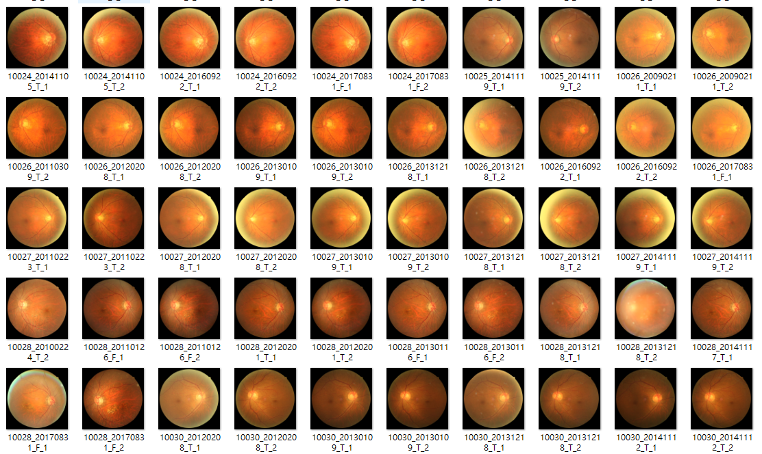
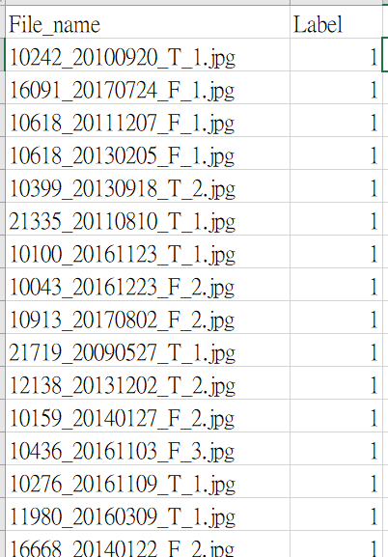
Dataset
image
label
Dataset
Introduction
Dataset
Image processing
Image preprocessing
Model selection
Model selection
Result
Result
Notes:
台北醫學中心

Slide 9

Dataset
Total : 2,080
0: 1,014
1: 1,066
Train
Total : 100
0: 50
1: 50
Validation
Total : 100
0: 50
1: 50
Test
Dataset
Introduction
Dataset
Image processing
Image preprocessing
Model selection
Model selection
Result
Result

Slide 10

Image Processing

Slide 11
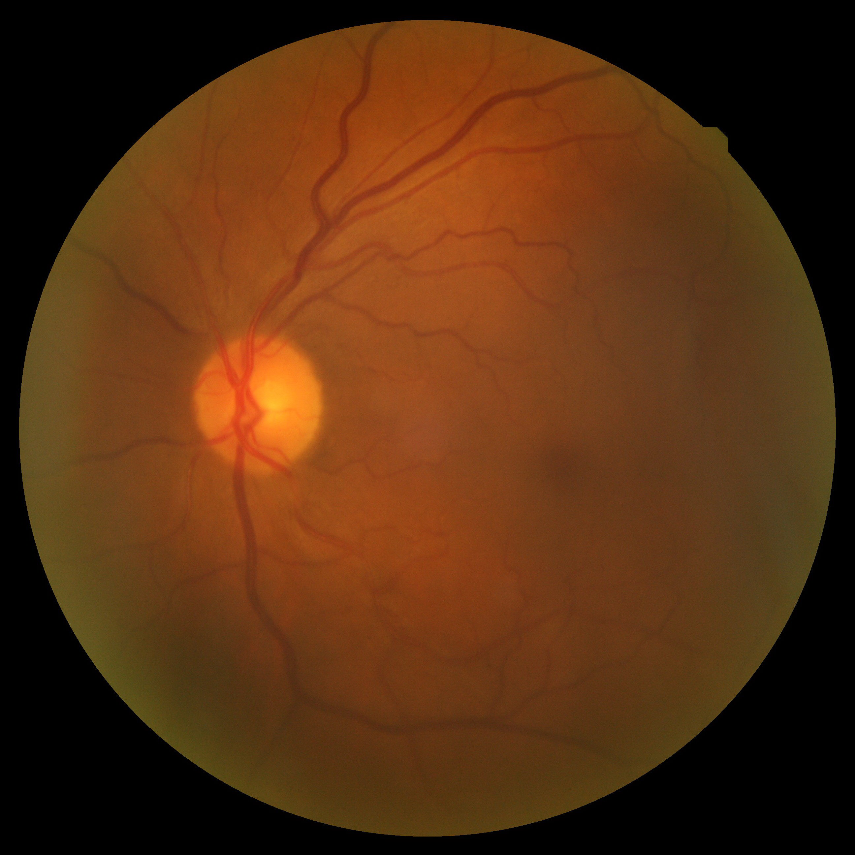
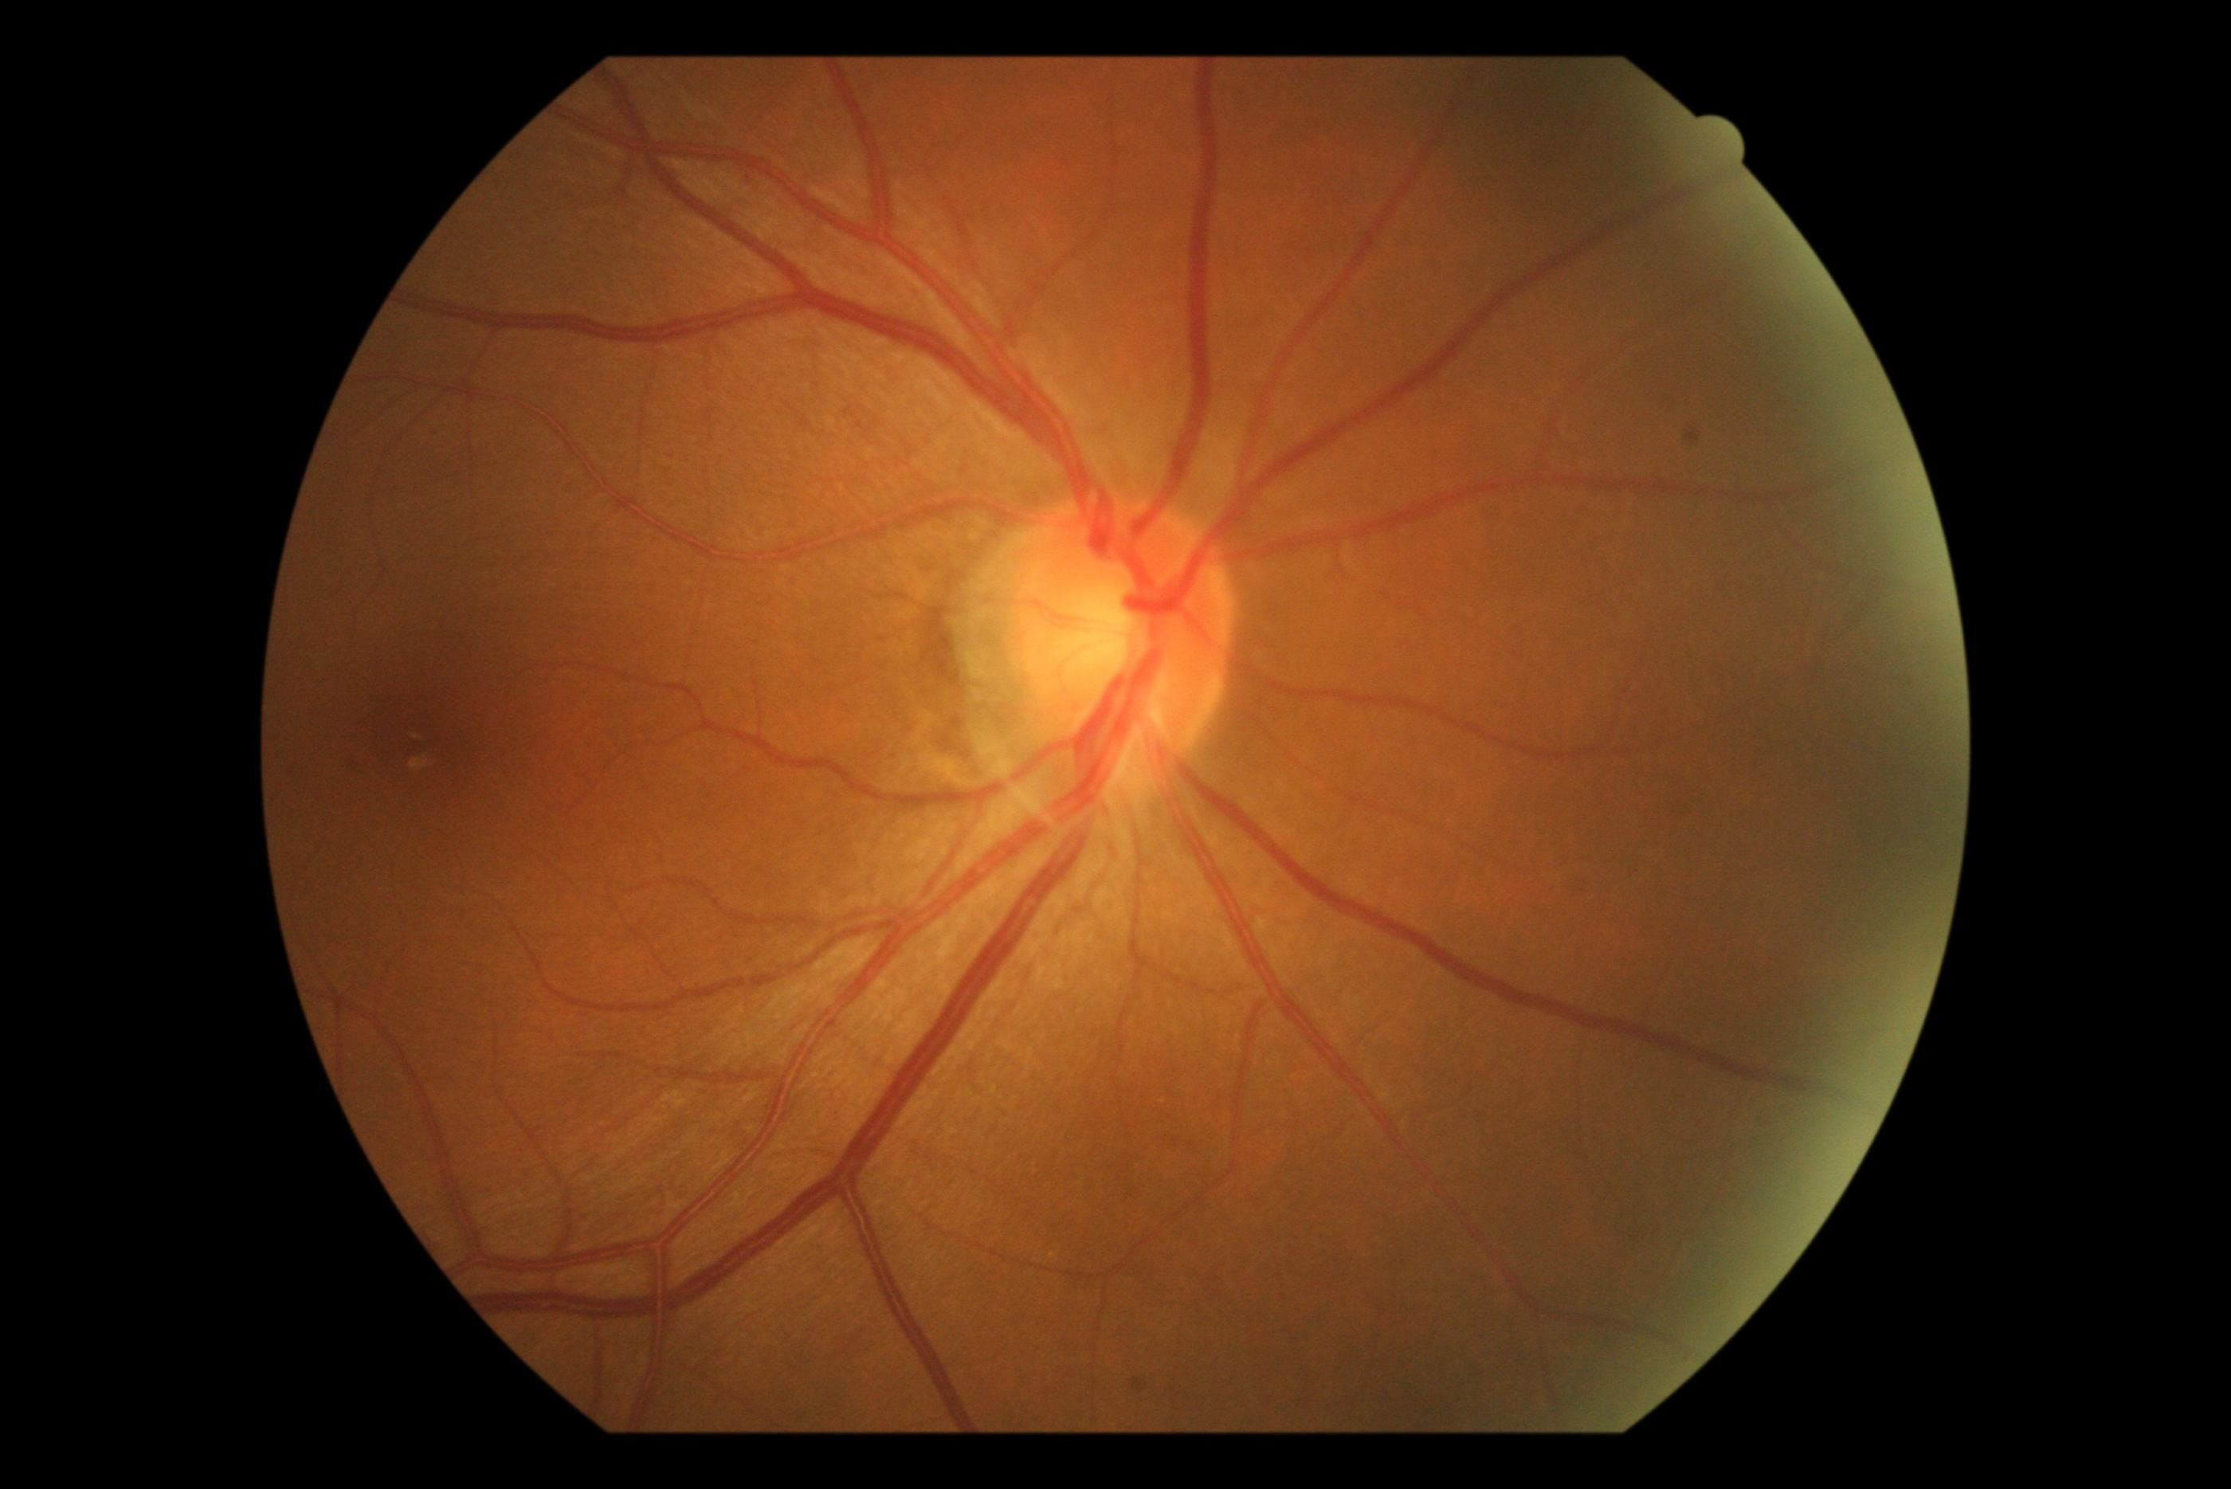
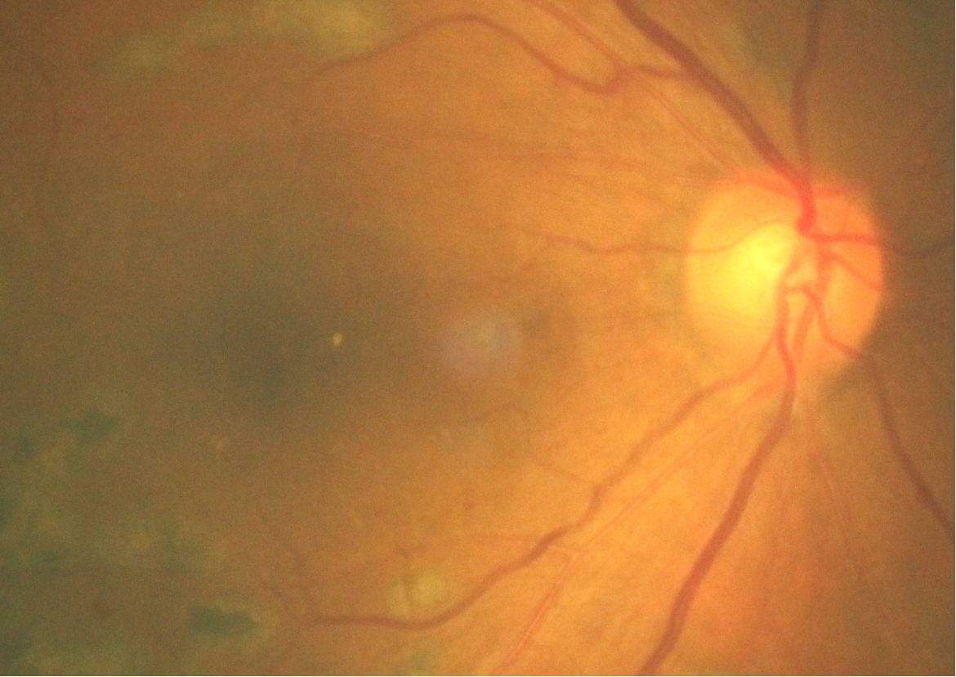
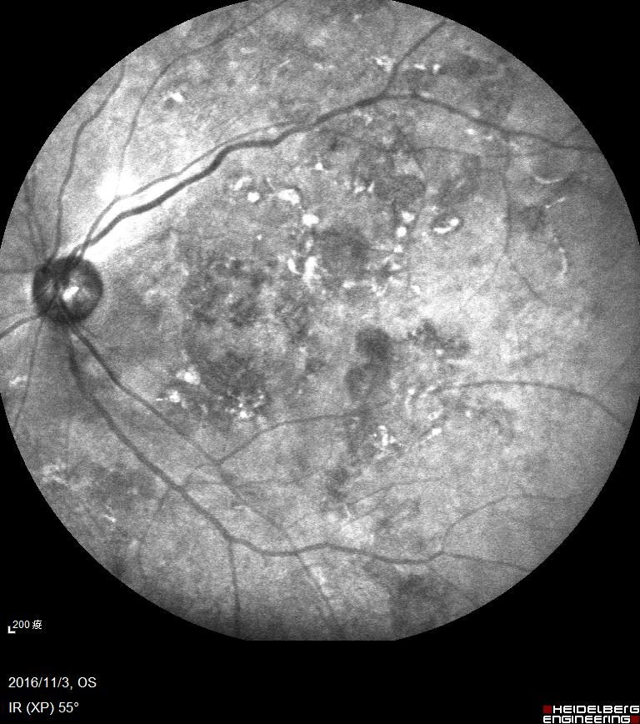
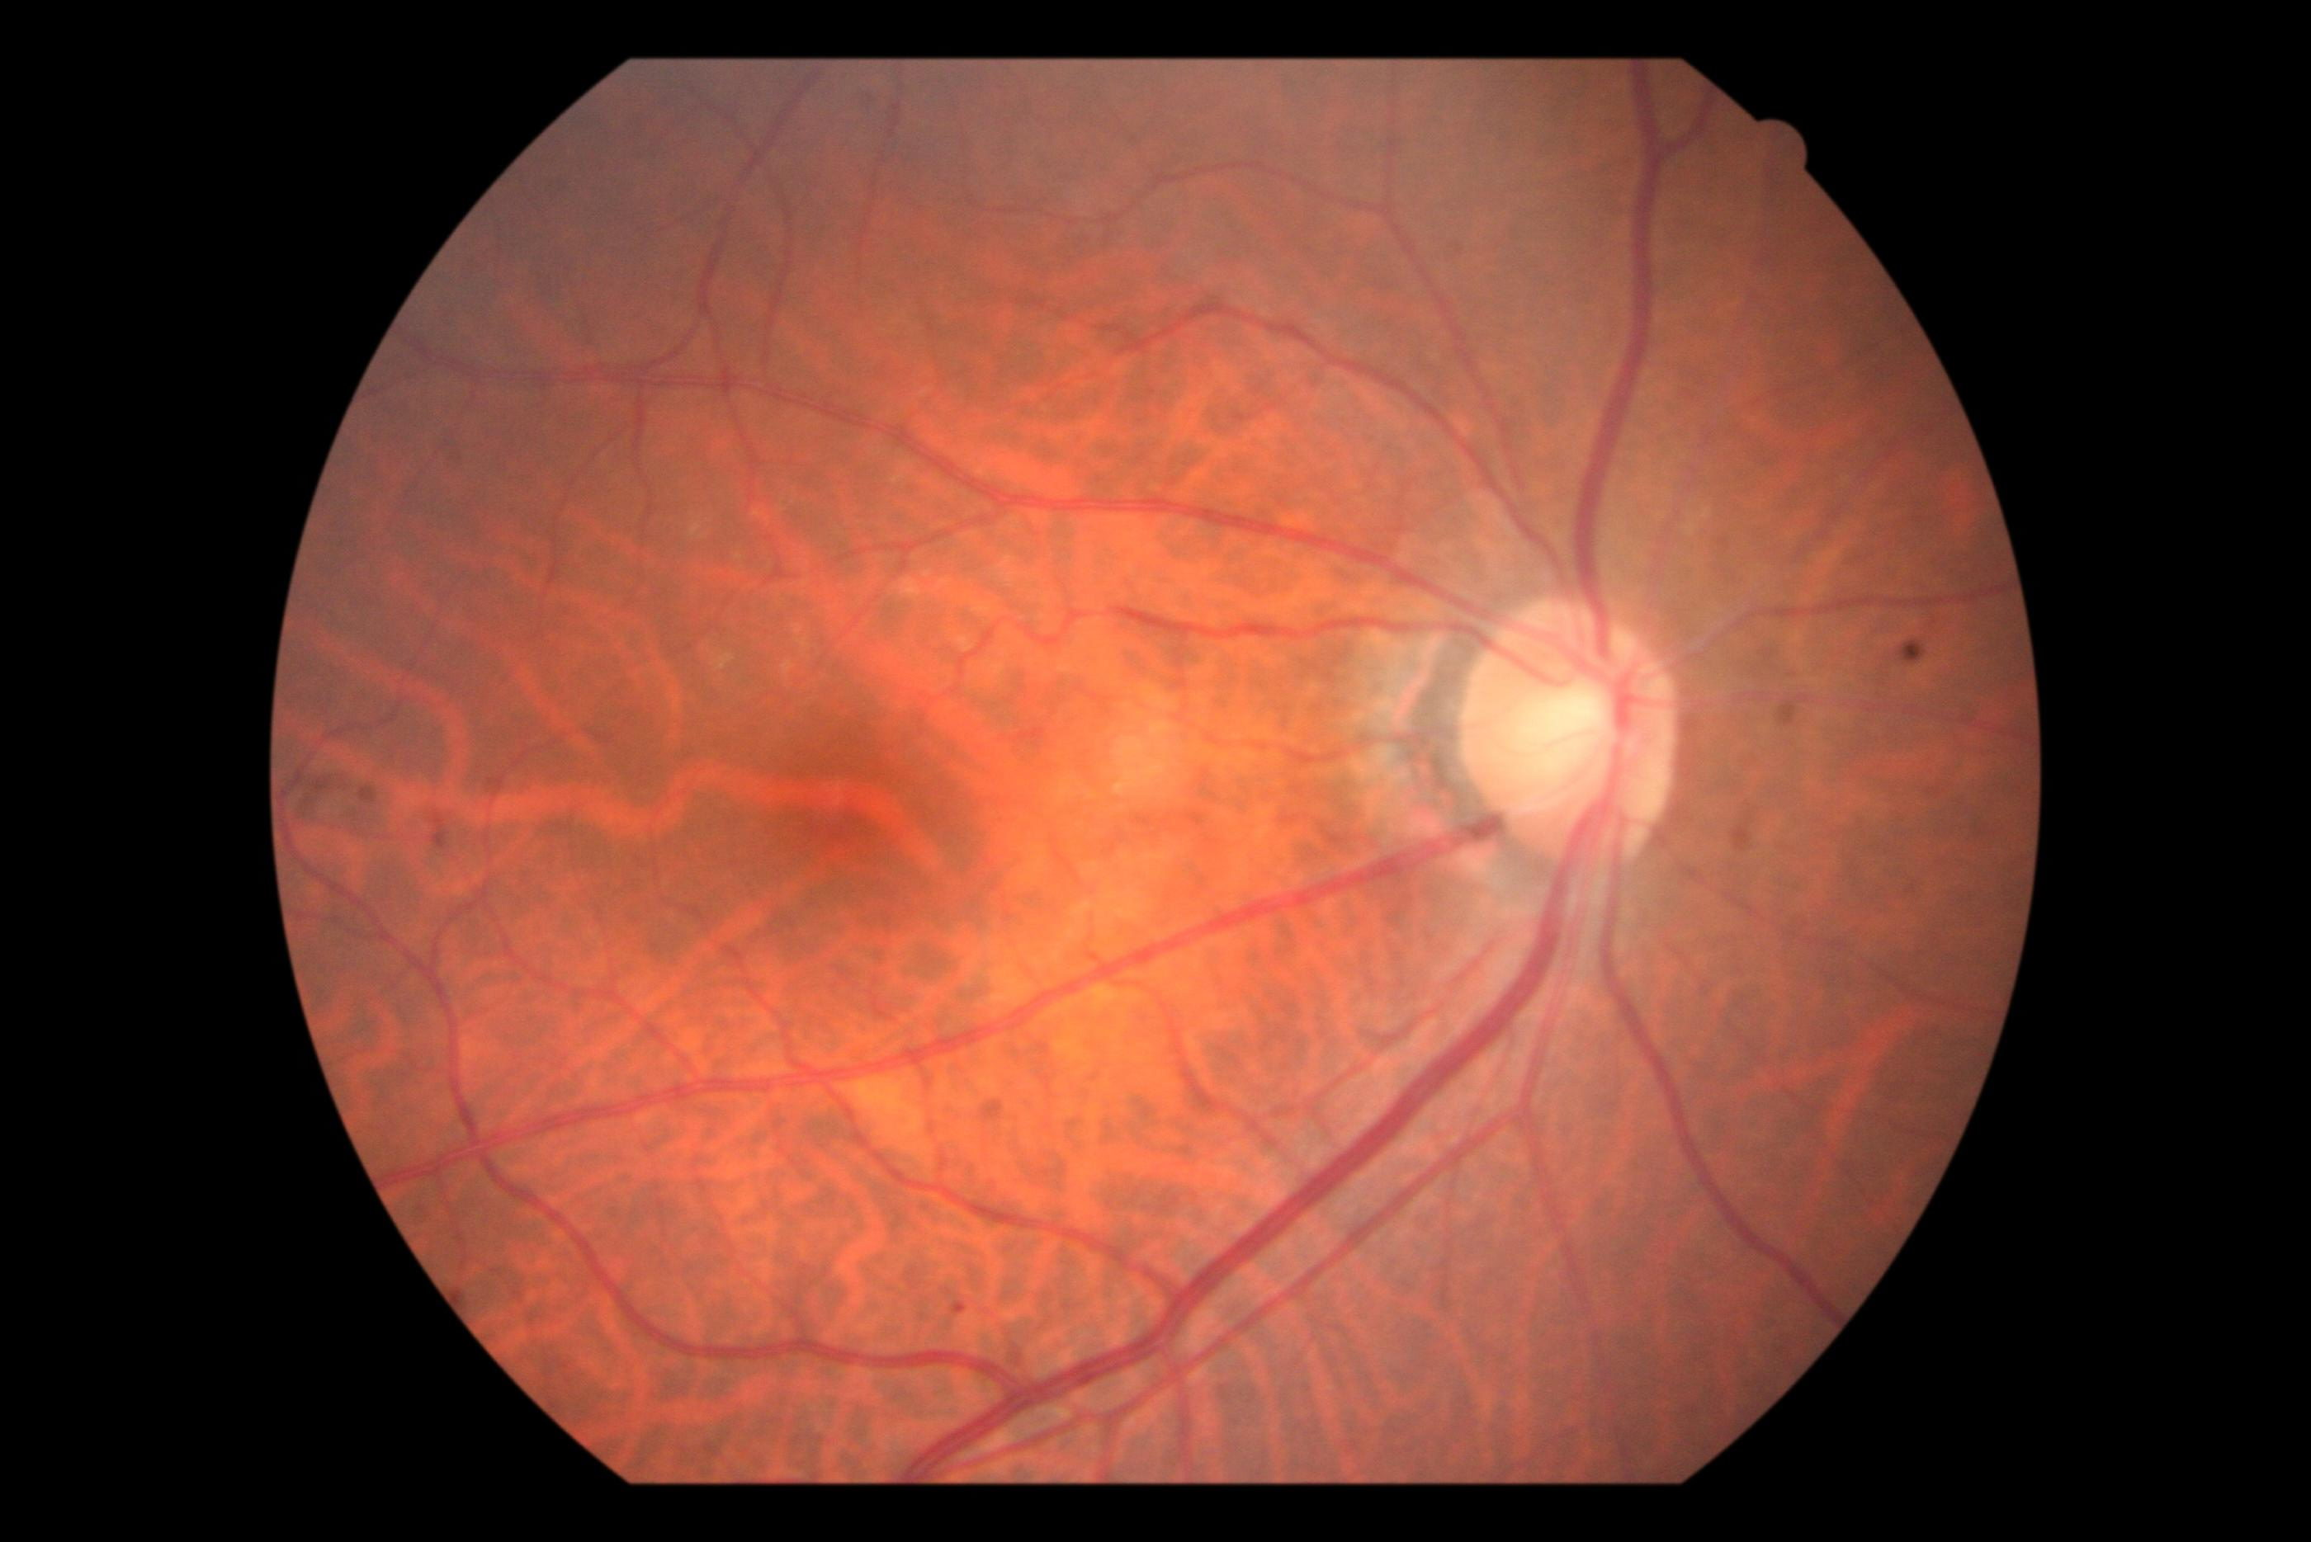
Image Processing : Step1
Normal
Abnormal
Using Image Size as Filter
Dataset
Introduction
Dataset
Image processing
Image processing
Model selection
Model selection
Result
Result

Slide 12
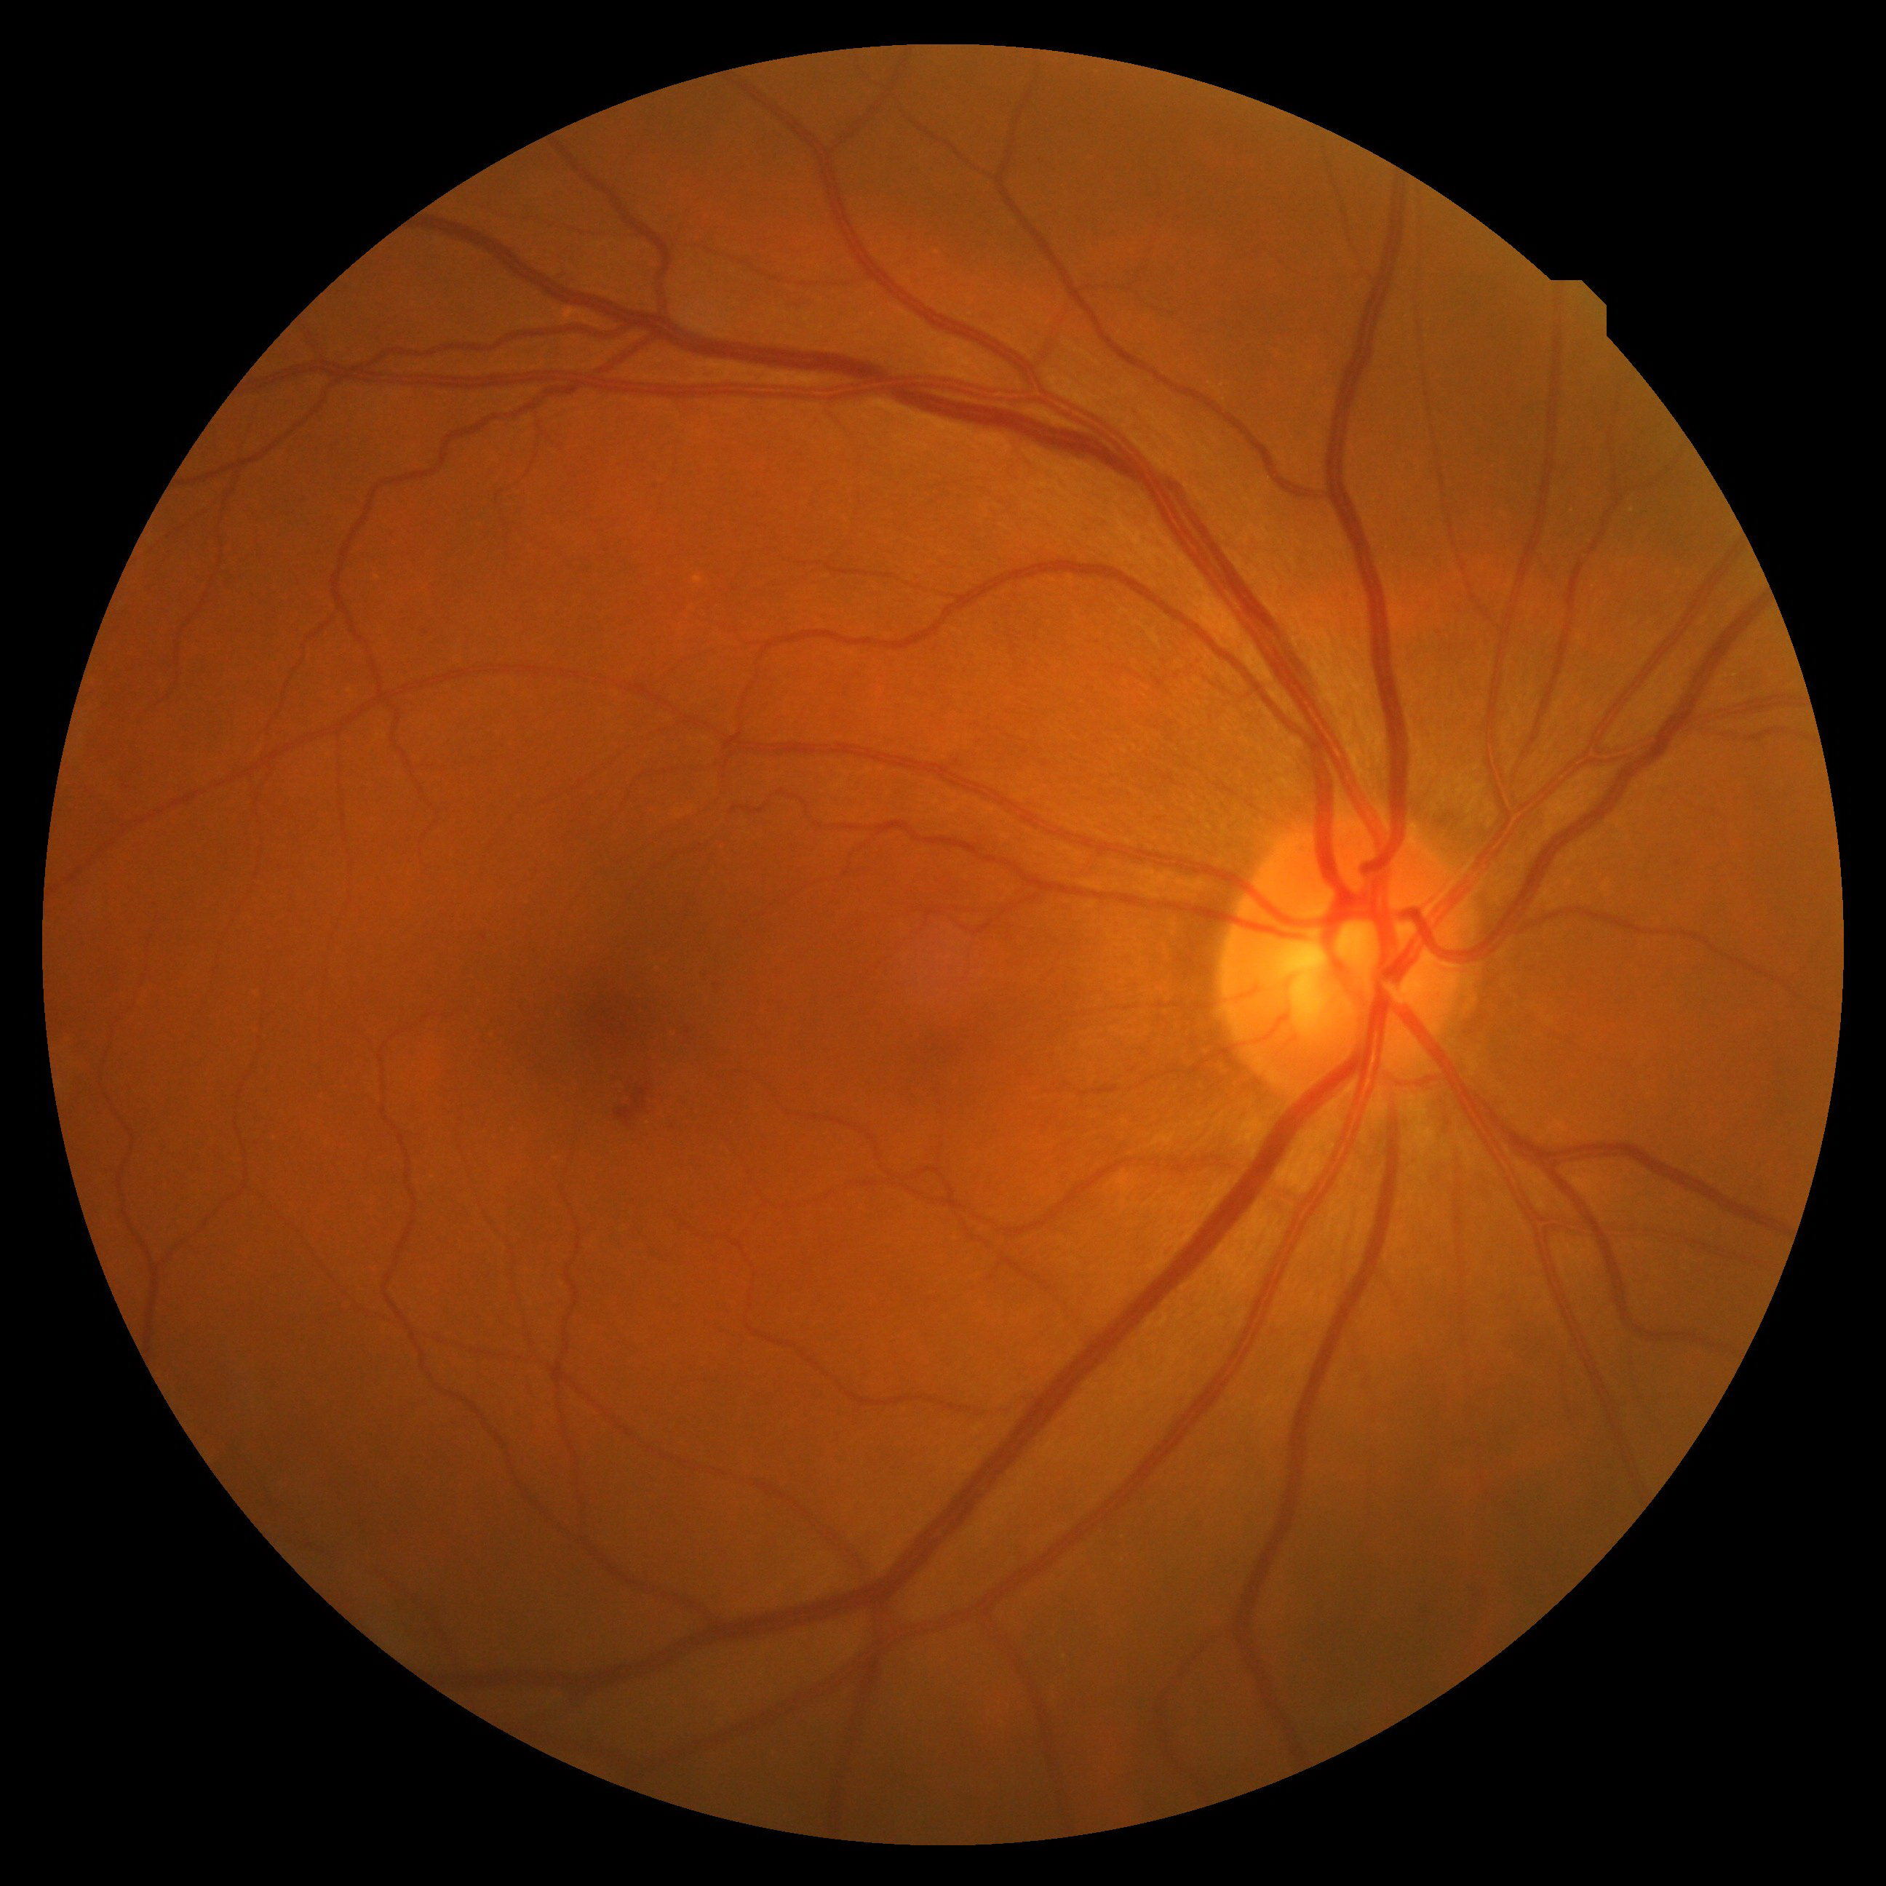
Image Processing : Step2
B
G
R
0 ~ 255
Dataset
Introduction
Dataset
Image processing
Image processing
Model selection
Model selection
Result
Result

Slide 13
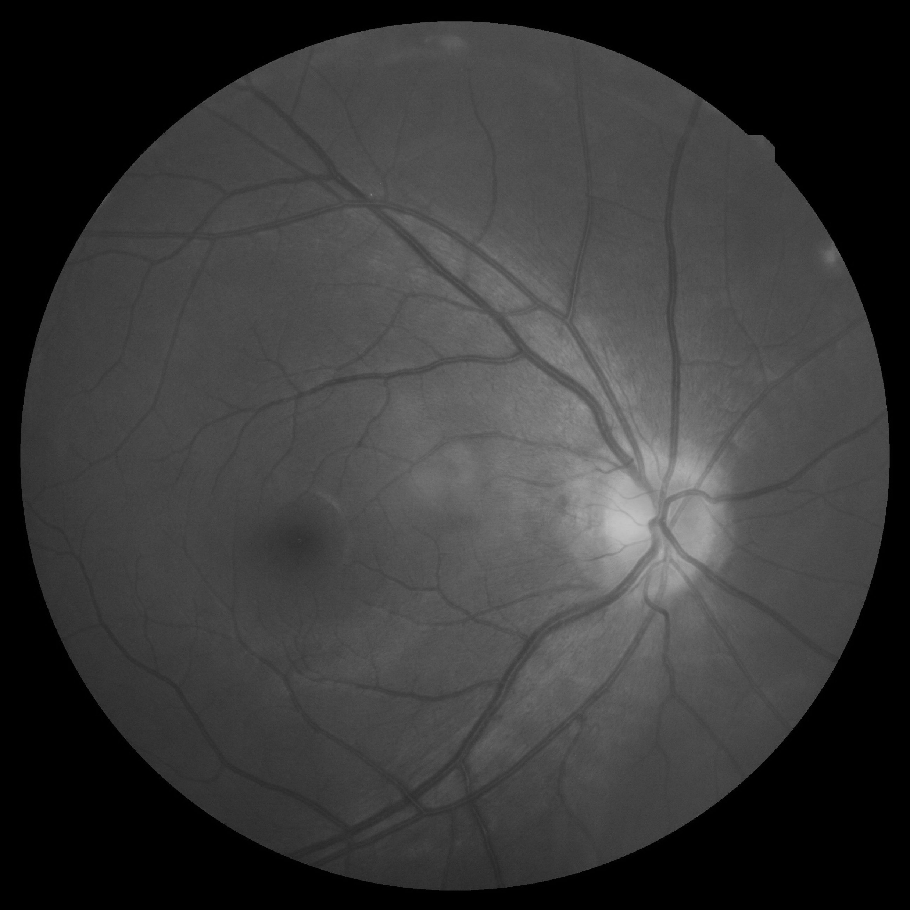
Image Processing : Step2
0 ~ 255
Dataset
Introduction
Dataset
Image processing
Image processing
Model selection
Model selection
Result
Result

Slide 14

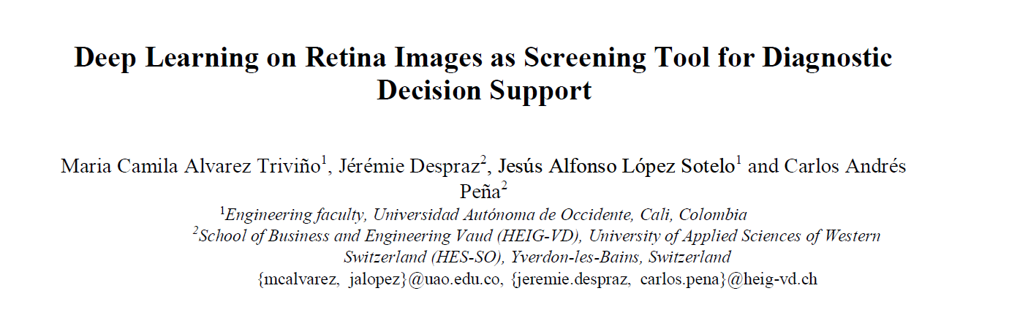

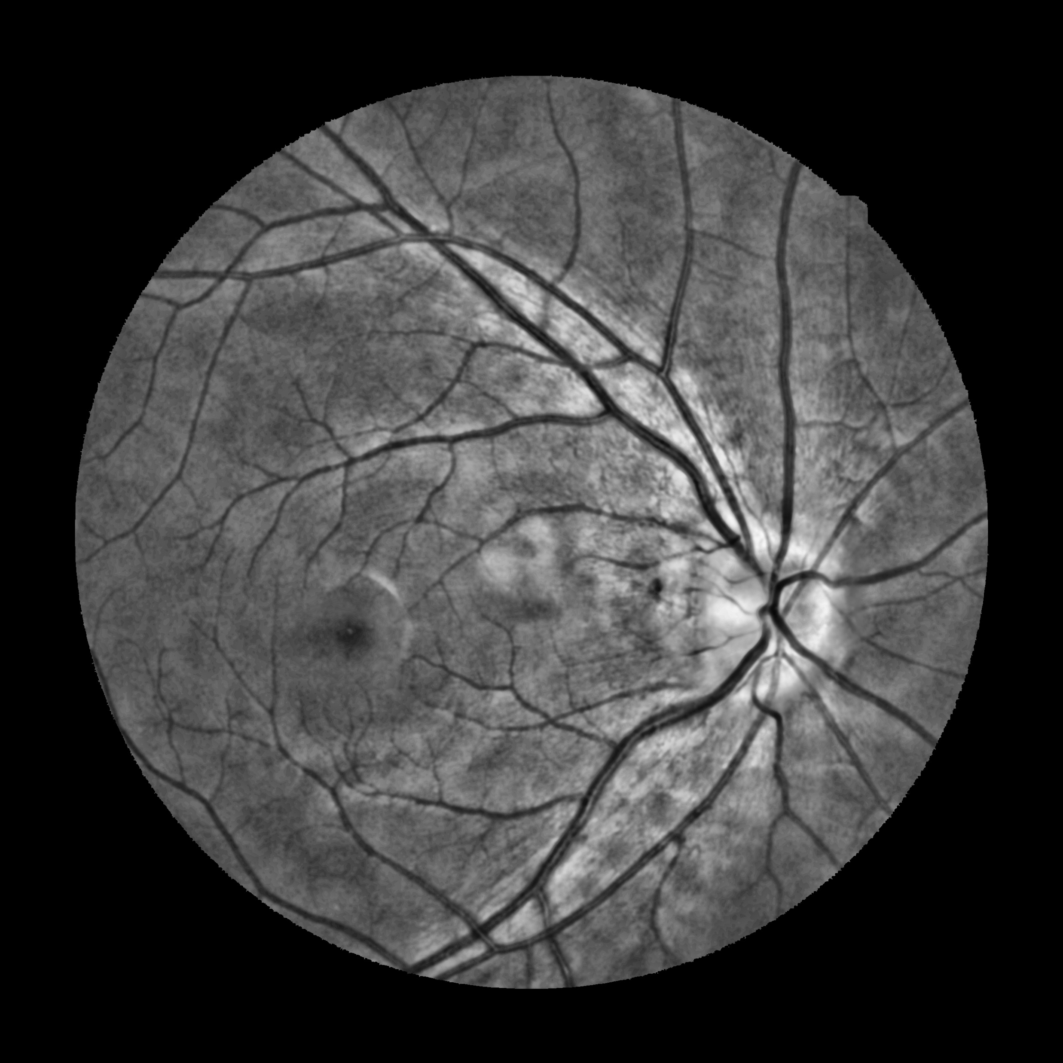
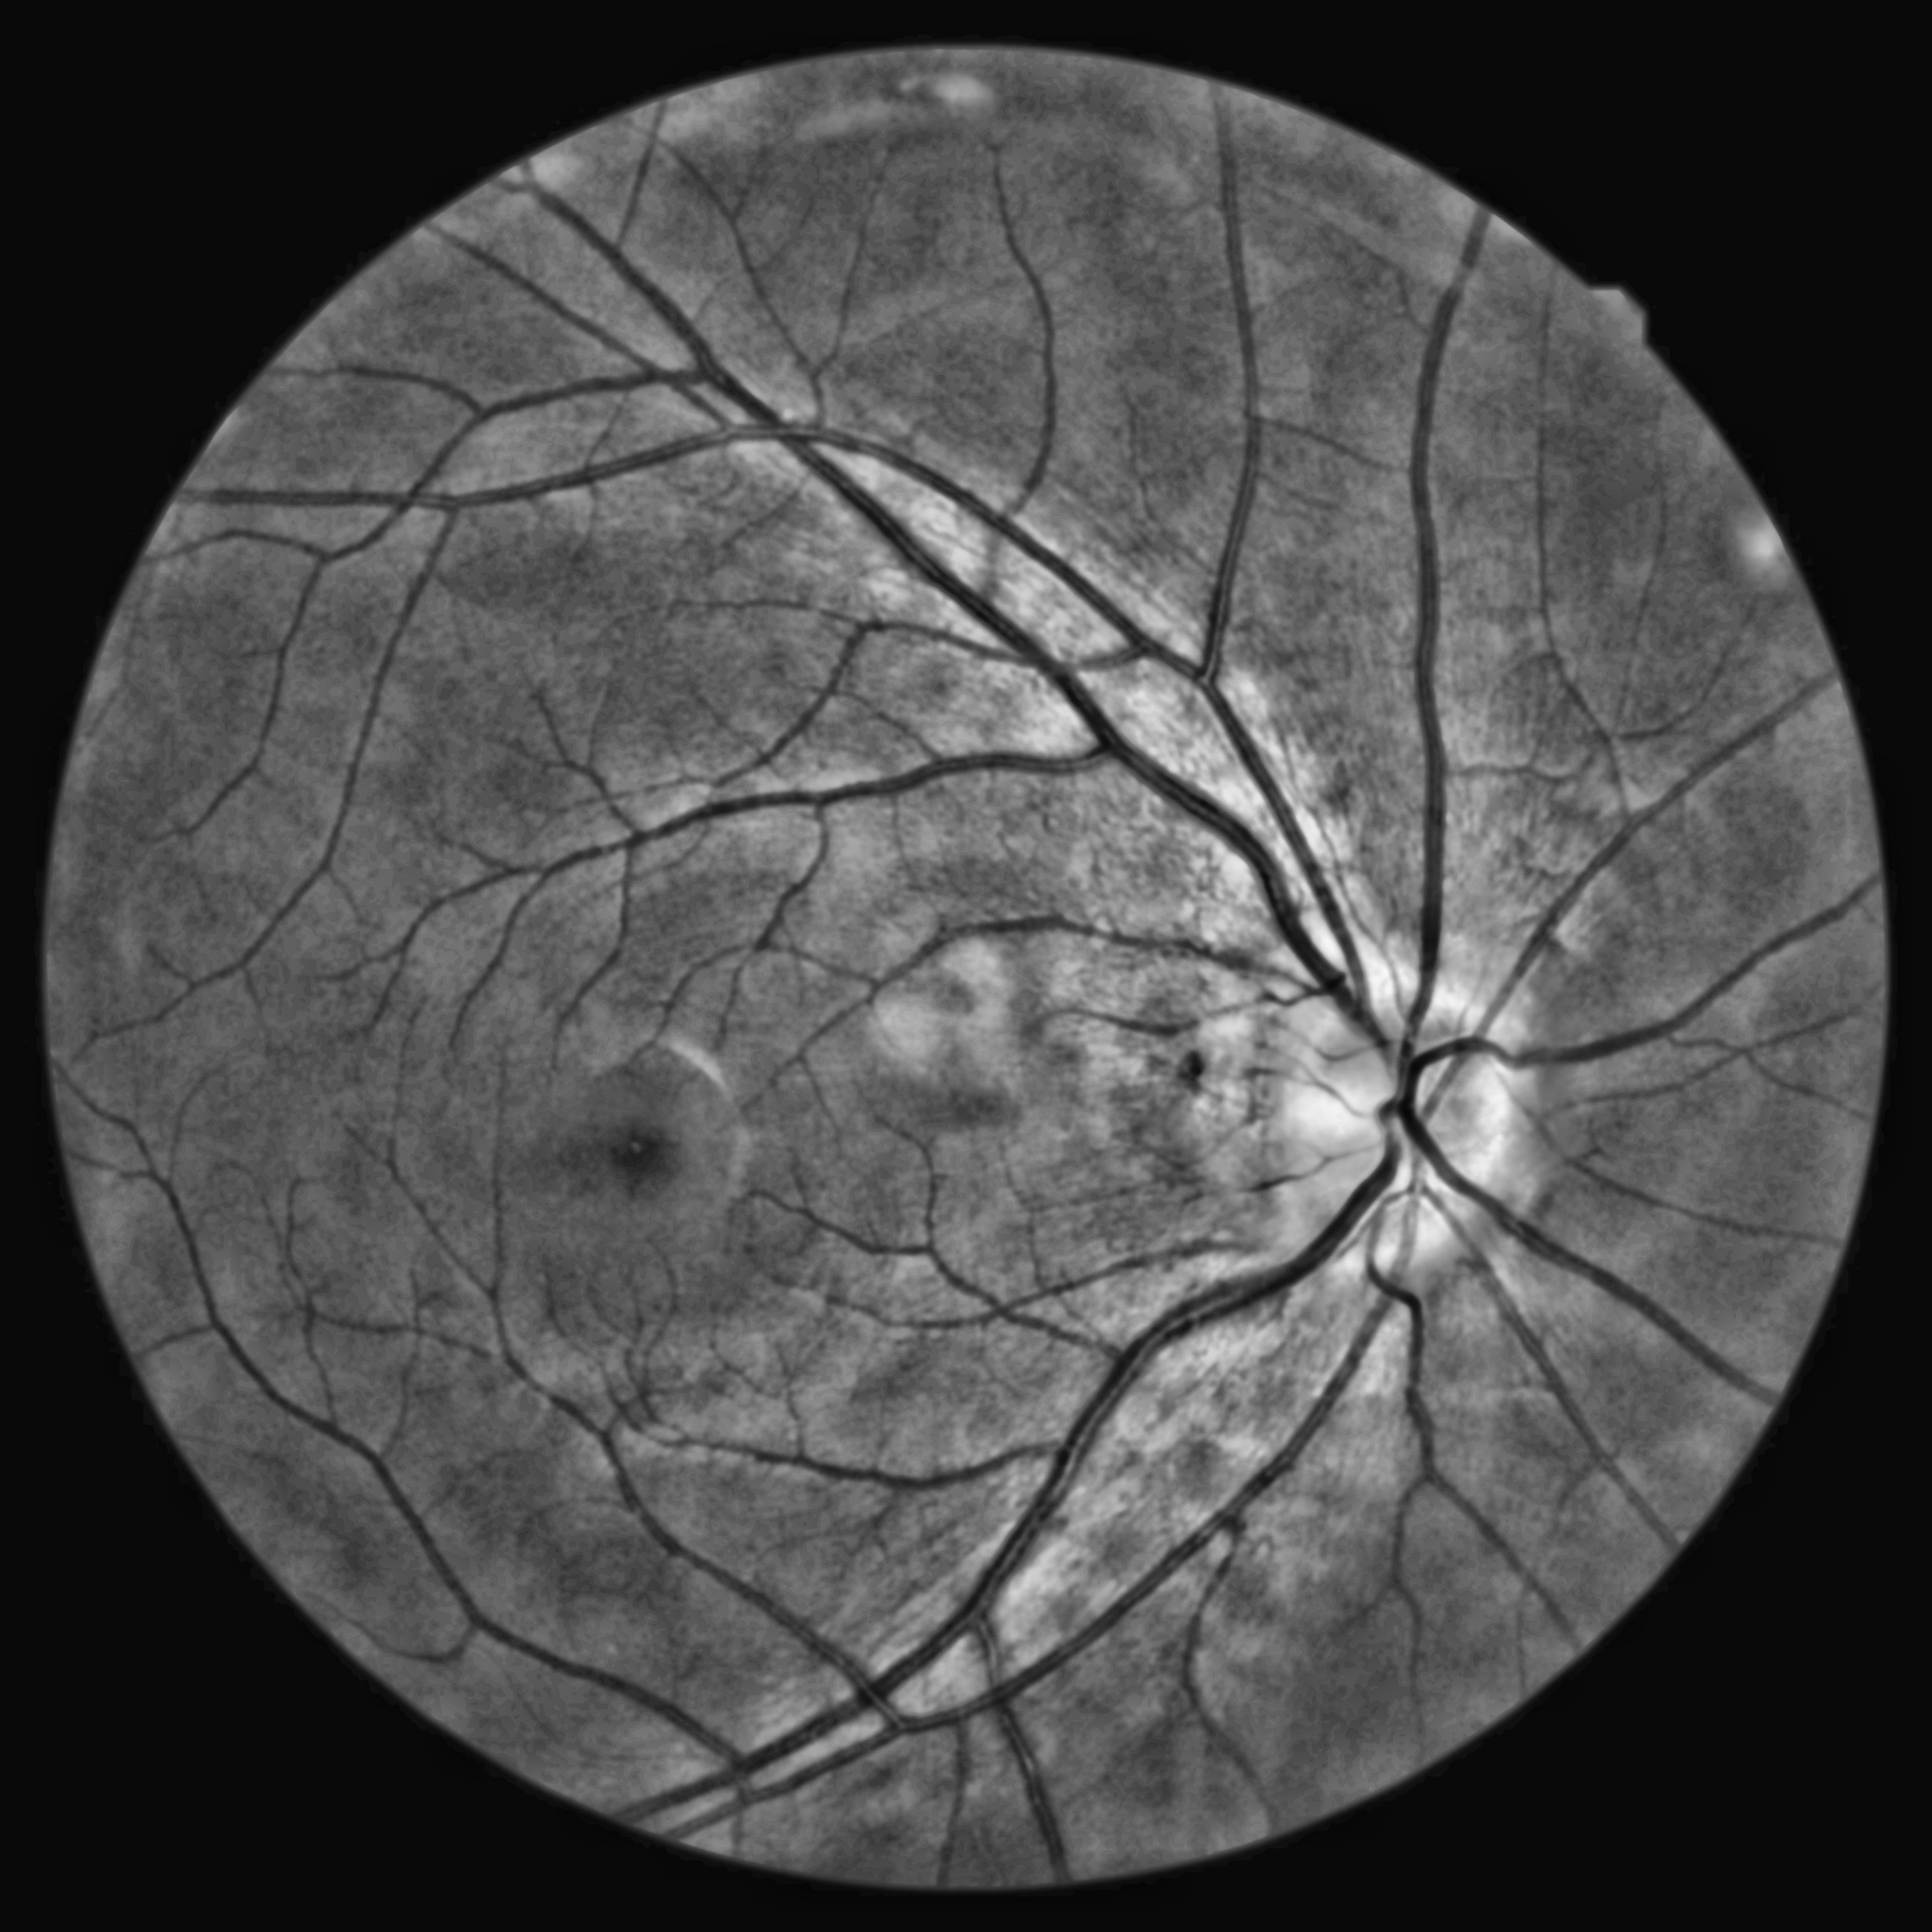
Image Preprocessing
Mask : reduce 10 % of its original size
-10%
CLAHE & Gaussian Filter
Dataset
Introduction
Dataset
Image processing
Image preprocessing
Model selection
Model selection
Result
Result
Notes:
CLAHE → contrast-limited adaptive histogram equalization

Slide 15
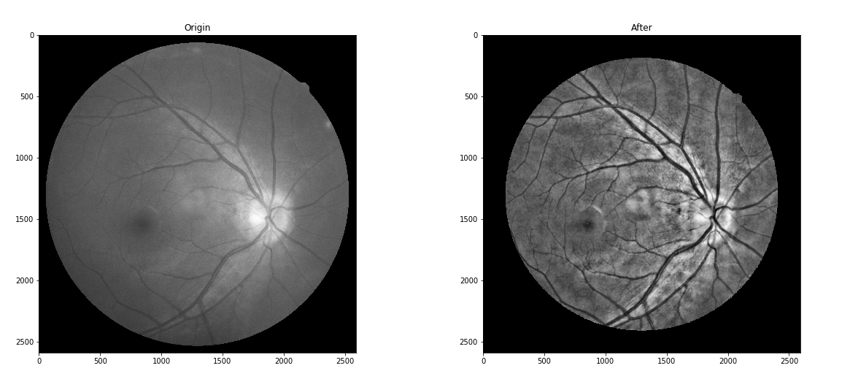
Image Preprocessing
Dataset
Introduction
Dataset
Image processing
Image preprocessing
Model selection
Model selection
Result
Result

Slide 16
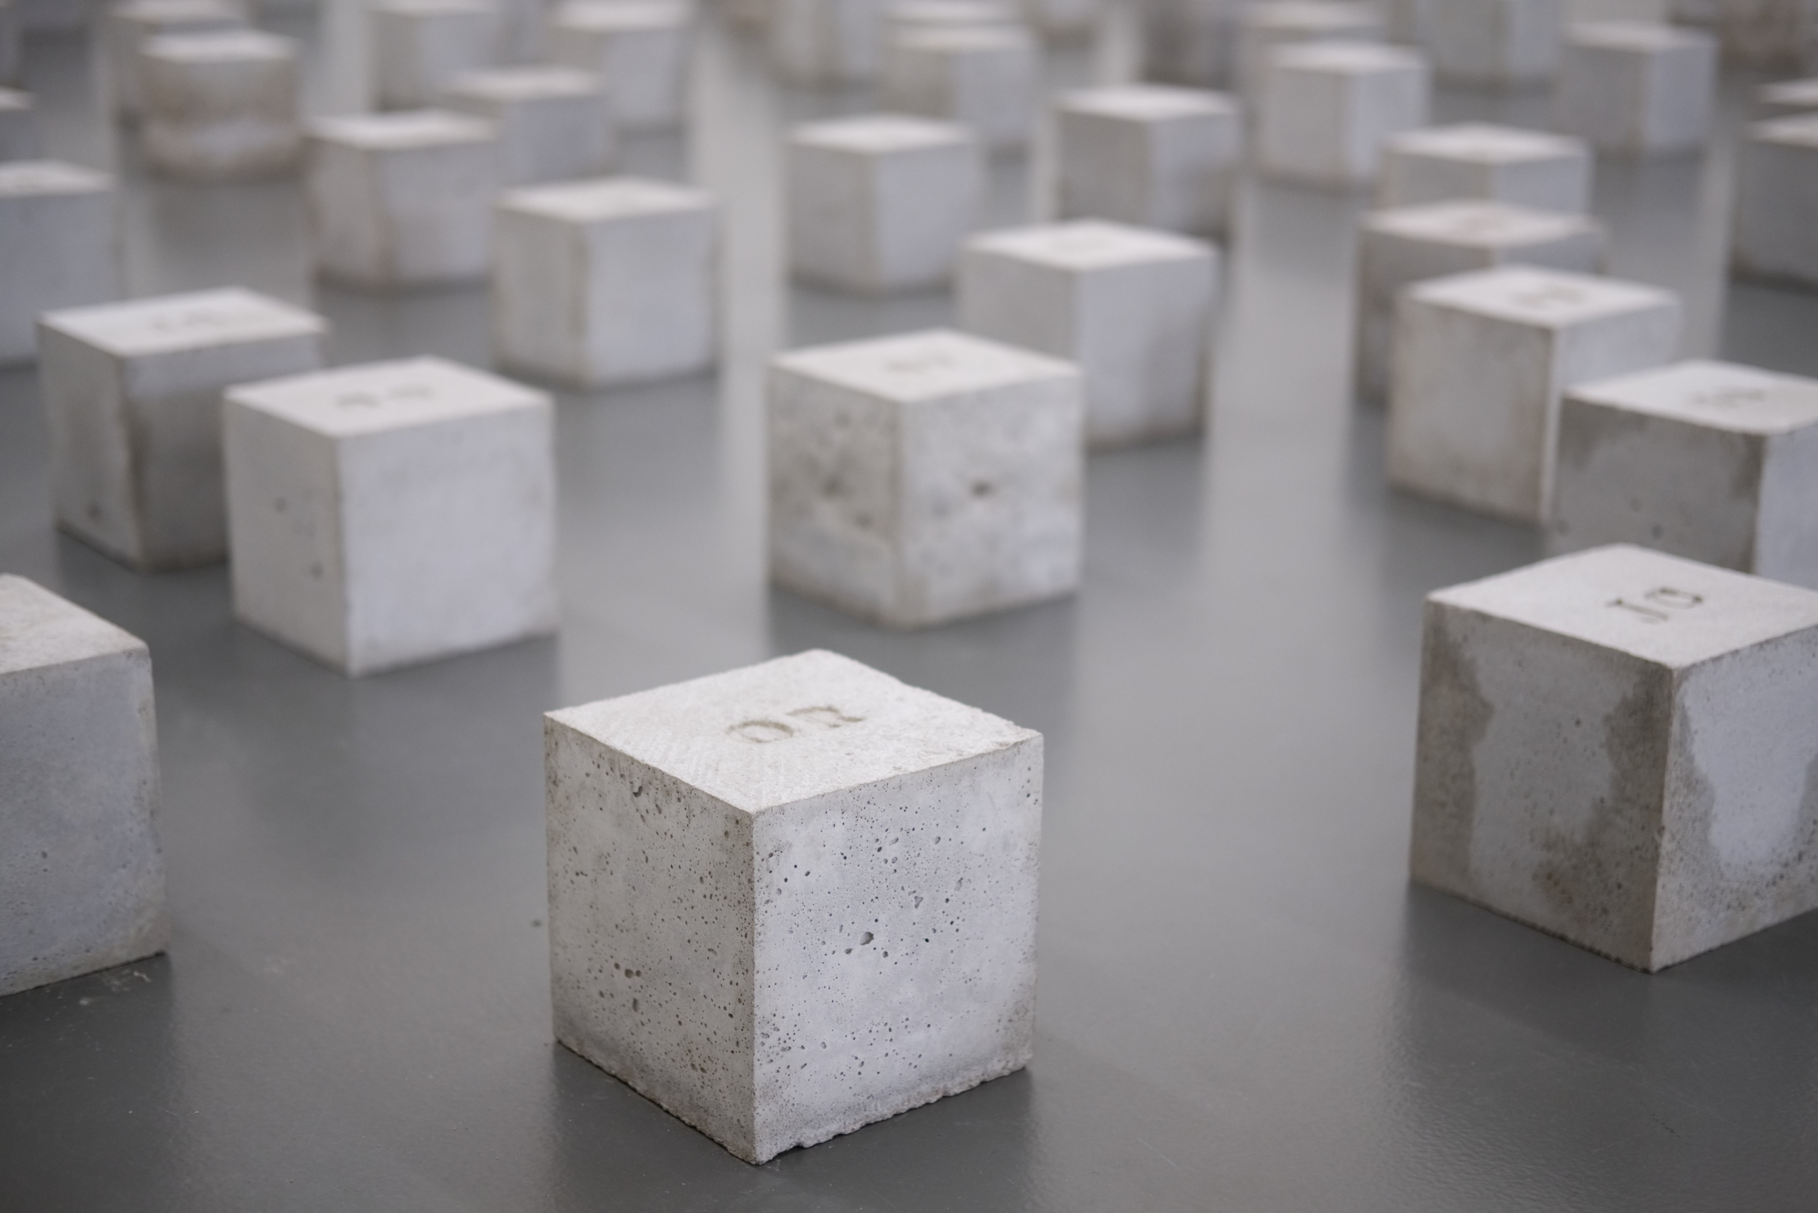
Model Selection

Slide 17
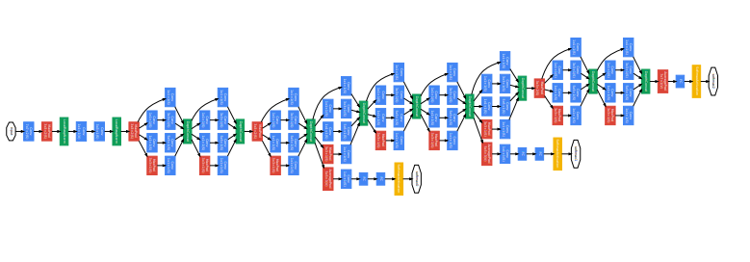
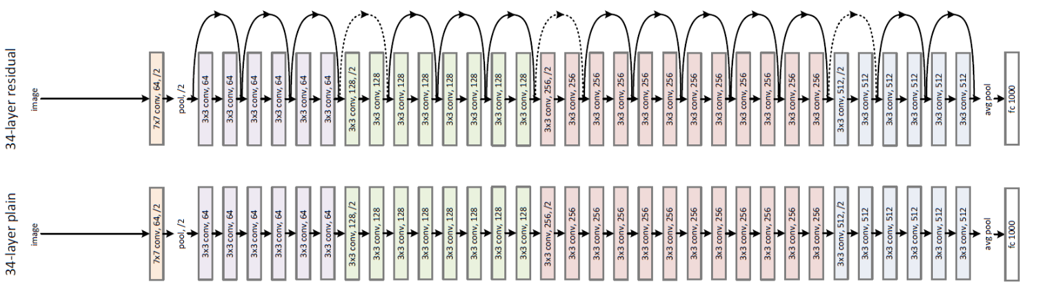
Model Selection
GoogLeNet
ResNet
Dataset
Introduction
Dataset
Image processing
Image preprocessing
Model selection
Model selection
Result
Result

Slide 18


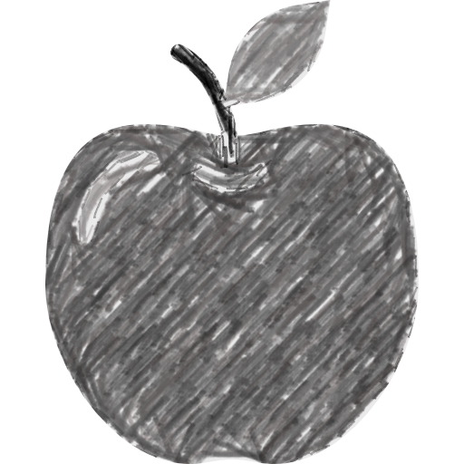
Model Selection : GoogLeNet
Traditional Conv Layer
Inception Layer
Output layer
Output layer
2 x 2 Max pooling
1 x 1 Conv
3 x 3 Conv
5 x 5 Conv
3 x 3 Max pooling
3 x 3 Convolutions
Previous layer
Previous layer
Dataset
Introduction
Dataset
Image processing
Image preprocessing
Model selection
Model selection
Result
Result

Slide 19
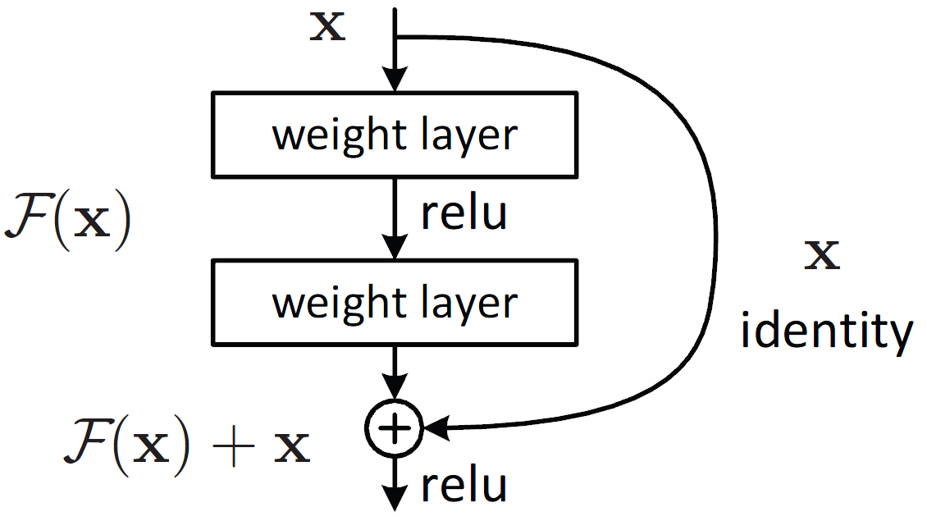
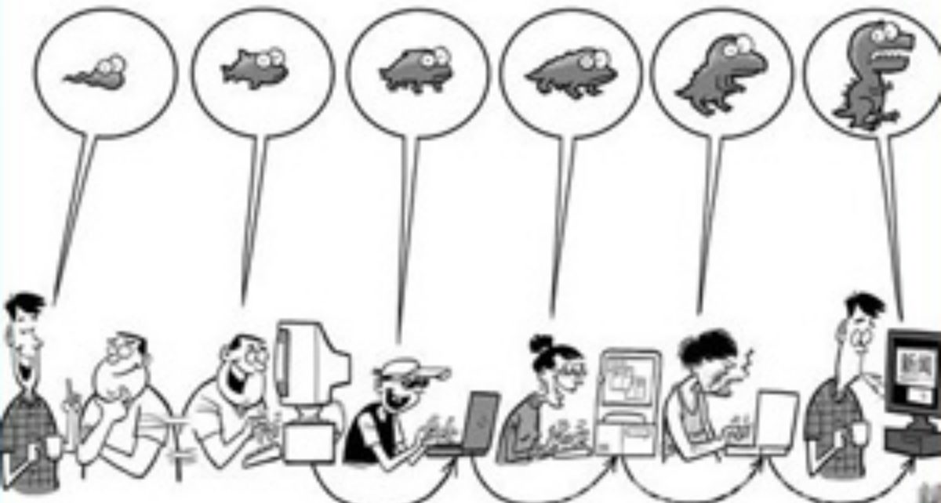
Model Selection : ResNet
Dataset
Introduction
Dataset
Image processing
Image preprocessing
Model selection
Model selection
Result
Result

Slide 20

Result

Slide 21
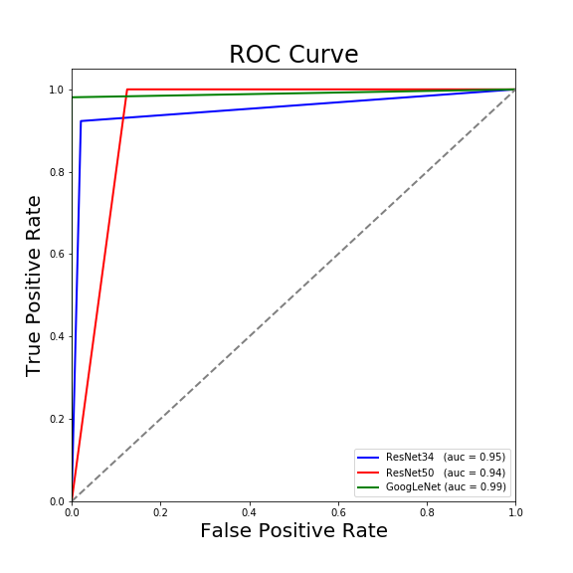
Result
Model | Acc
Resnet34 | 95%
Resnet50 | 94%
GoogLeNet | 99%
Dataset
Introduction
Dataset
Image processing
Image preprocessing
Model selection
Model selection
Result
Result

Slide 22
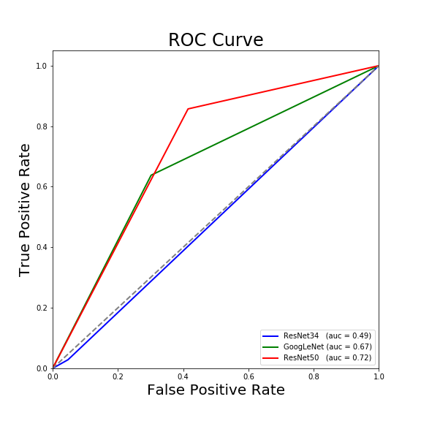
Result
Dataset
Introduction
Dataset
Image processing
Image processing
Model selection
Model selection
Result
Result

Slide 23
Result
How to improve model accuracy?
Data augmentation (ex: rotation)
Data Preprocessing (other methods)
More Data
Dataset
Introduction
Dataset
Image processing
Image preprocessing
Model selection
Model selection
Result
Result

Slide 24
Thanks for Listening!

Slide 25
Q & A

